Slide 1
Cinemagraph Auto Compose
COMP820, Video and Image Processing
Yuankai Zhu, 21134118

Slide 2
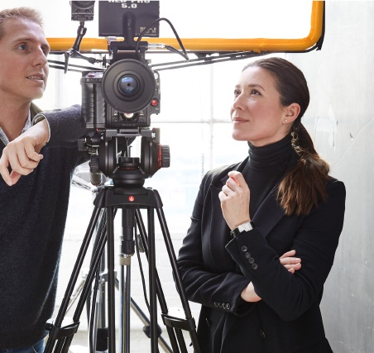


What is Cinemagraph
Cinemagraphs are still photographs in which a minor and repeated movement occurs, forming a video clip.
The first cinemagraph was recorded in 2011.
“Kevin Burg and Jamie Beck are the inventors of the cinemagraph and pioneers in this new medium of photography.”
Cinemagraphs.com. (2023). About Retrieved from http://cinemagraphs.com/about

Slide 3
Some Examples
Burg, K. & Beck, J. (n.d.). The train to Machu Picchu [Image].
Cinemagraphs.com. Retrieved from http://cinemagraphs.com
Notes:
3

Slide 4
Some Examples
Burg, K. & Beck, J. (n.d.). News [Image]. Cinemagraphs.com.
Retrieved from http://cinemagraphs.com
Notes:
4

Slide 5
Some Examples
Burg, K. & Beck, J. (n.d.). Client: Chopard [Image]. Cinemagraphs.com.
Retrieved from http://cinemagraphs.com
Notes:
5

Slide 6
2 frames example
Yuankai, Zhu. (2023). Metalhead [Image]
Notes:
6

Slide 7
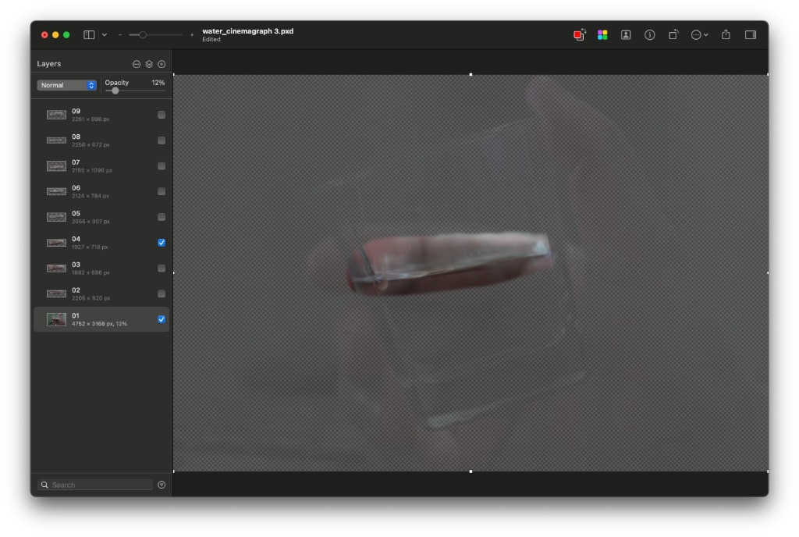
The vintage way
Yuankai, Zhu. (2014). Just water demo [Image]
Notes:
7

Slide 8
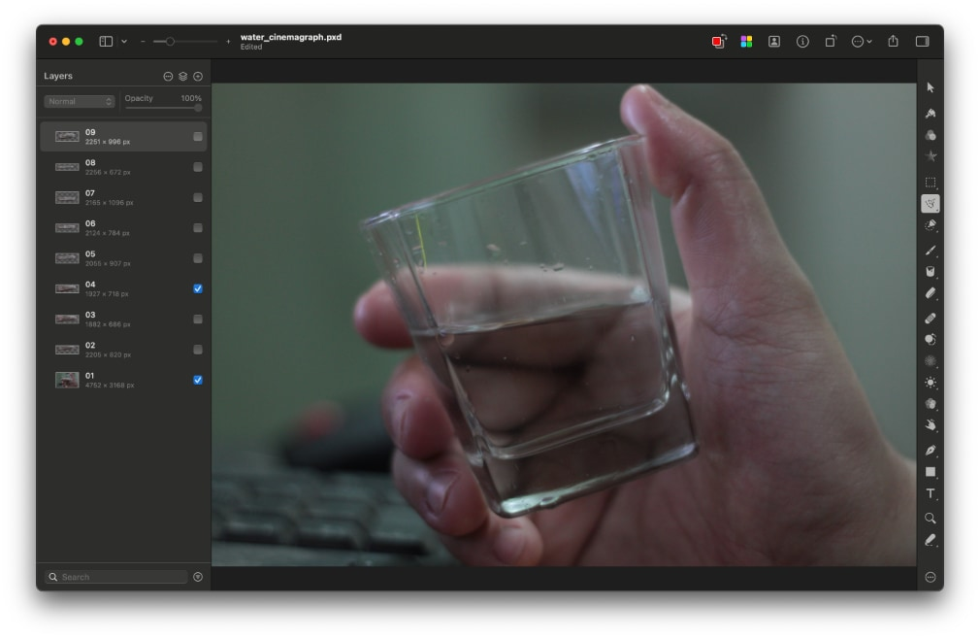
The vintage way
Yuankai, Zhu. (2014). Just water demo [Image]
Notes:
8

Slide 9
The vintage way
Yuankai, Zhu. (2014). Just water demo [Image]
Notes:
9

Slide 10
The vintage way
Yuankai, Zhu. (2014). Just water demo [Image]
Notes:
10

Slide 11
Template Matching in OpenCV
cv.matchTemplate (image, templ, result, method, mask = new cv.Mat())
Parameters
image (image where the search is running. It must be 8-bit or 32-bit floating-point.)
templ (searched template. It must be not greater than the source image and have the same data type.)
result (map of comparison results. It must be single-channel 32-bit floating-point.)
method (parameter specifying the comparison method, see cv.TemplateMatchModes.)
mask (mask of searched template. It must have the same datatype and size with templ. It is not set by default.)
OpenCV. (n.d.). matchTemplate(). Retrieved September 17, 2021,
from https://docs.opencv.org/4.x/df/dfb/group__imgproc__object.html
Notes:
11

Slide 12
Theory
Template Matching is a method for searching and finding the location of a template image in a larger image. OpenCV comes with a function cv.matchTemplate() for this purpose. It simply slides the template image over the input image (as in 2D convolution) and compares the template and patch of input image under the template image. Several comparison methods are implemented in OpenCV. (You can check docs for more details). It returns a grayscale image, where each pixel denotes how much does the neighbourhood of that pixel match with template.
If input image is of size (WxH) and template image is of size (wxh), output image will have a size of (W-w+1, H-h+1). Once you got the result, you can use cv.minMaxLoc() function to find where is the maximum/minimum value. Take it as the top-left corner of rectangle and take (w,h) as width and height of the rectangle. That rectangle is your region of template.
OpenCV. (n.d.). matchTemplate(). Retrieved September 17, 2021,
from https://docs.opencv.org/4.x/df/dfb/group__imgproc__object.html
Notes:
12

Slide 13
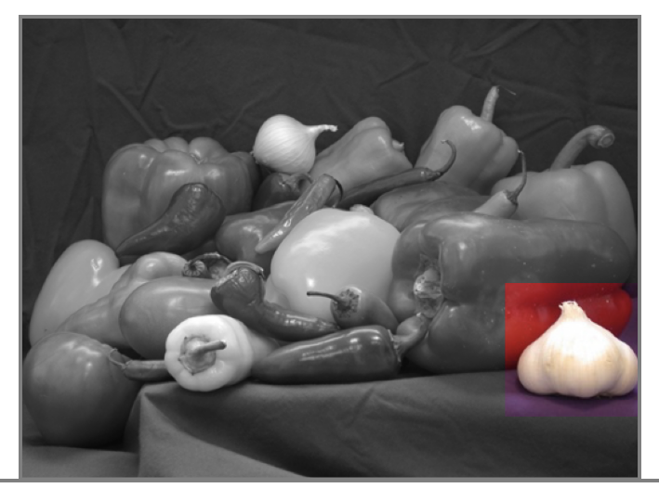
Modes cv.TM_CCOEFF

Slide 14
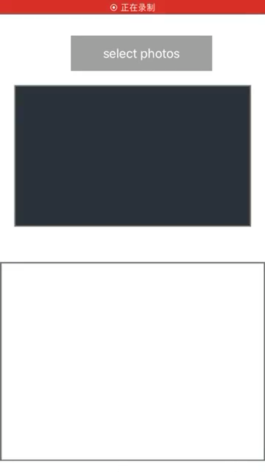
App Demo
14/30

Slide 15
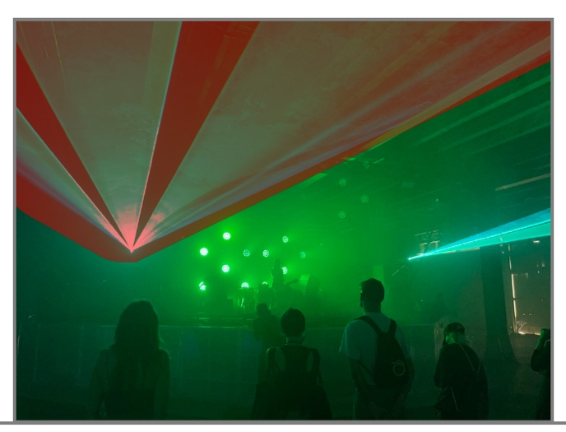

Template Match Demo
Matching results from the console :
[0.738948, 0.701110, 0.652286, 0.667243, 0.683662, 0.752907, 0.744485, 0.764951, 0.726609]

Slide 16
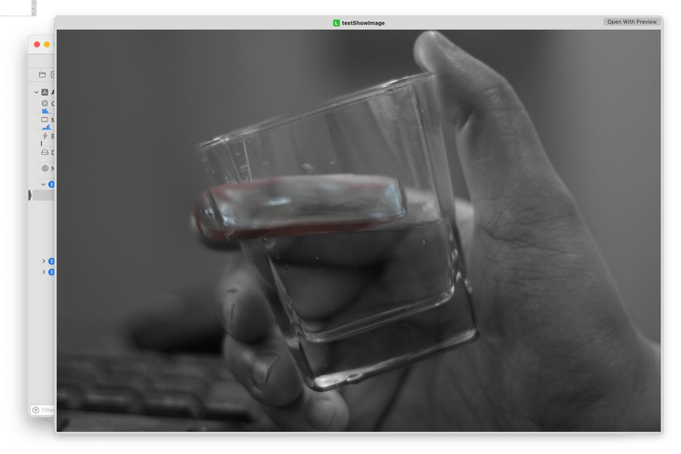
Failures

Slide 17
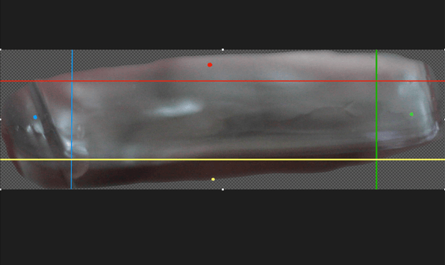
Failures

Slide 18
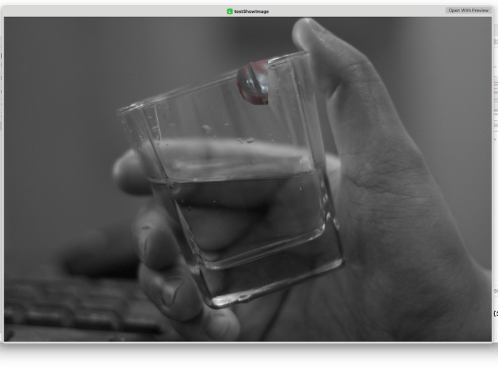
Failures

Slide 19
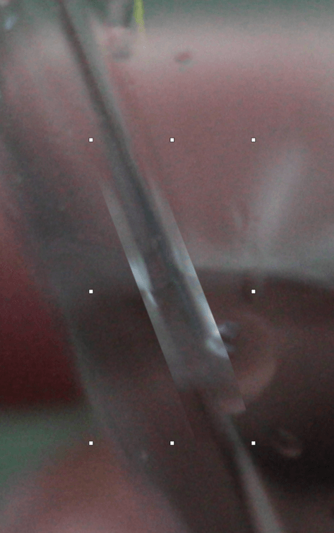
Computer Vison vs Human Vison

Slide 20
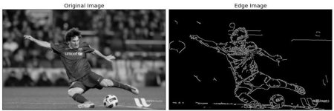
Canny Edge Detection
It is a popular edge detection algorithm developed by John F. Canny .
It is a multi-stage algorithm with "Noise Reduction", "Finding Intensity Gradient of the Image", "Non-maximum Suppression", "Hysteresis Thresholding".
OpenCV. (2020). Canny Edge Detection. Retrieved March 25, 2023,
from https://docs.opencv.org/4.2.0/da/d22/tutorial_py_canny.html

Slide 21
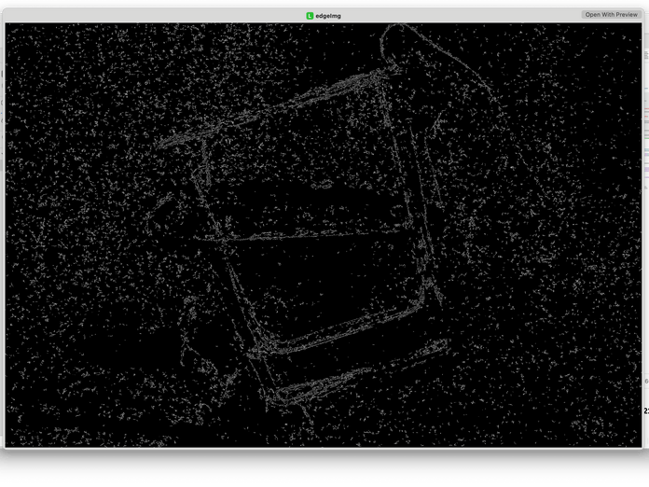
More Failures
I’ve got a worse result at “matched point:1757,17 maxVal:0.027743”.

Slide 22
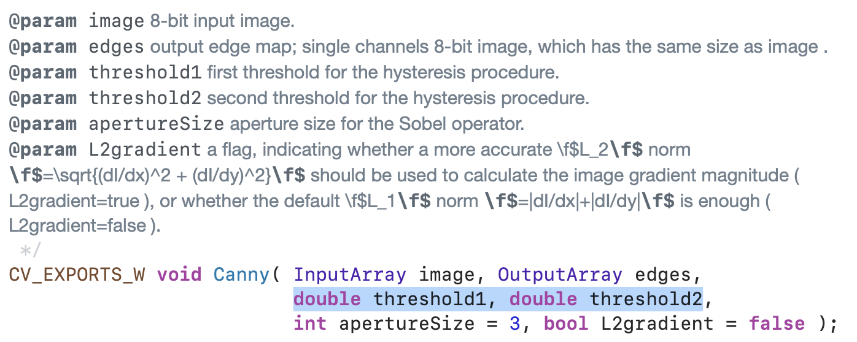
cv::Canny()

Slide 23
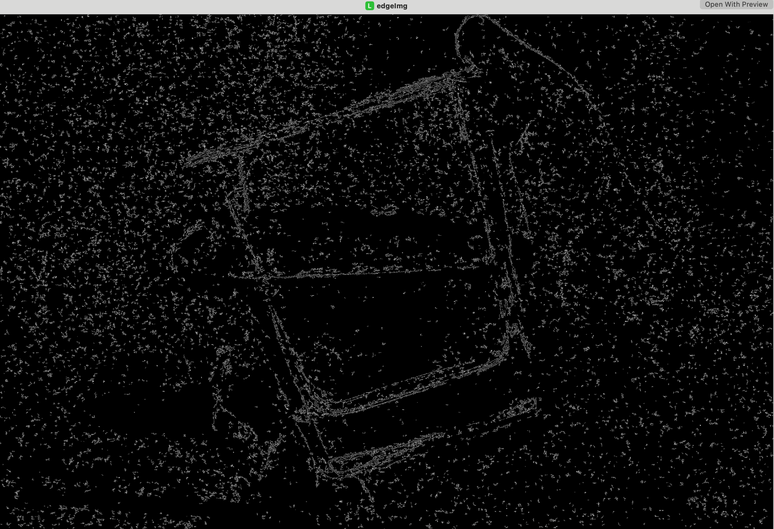
Different Thresholds

Slide 24
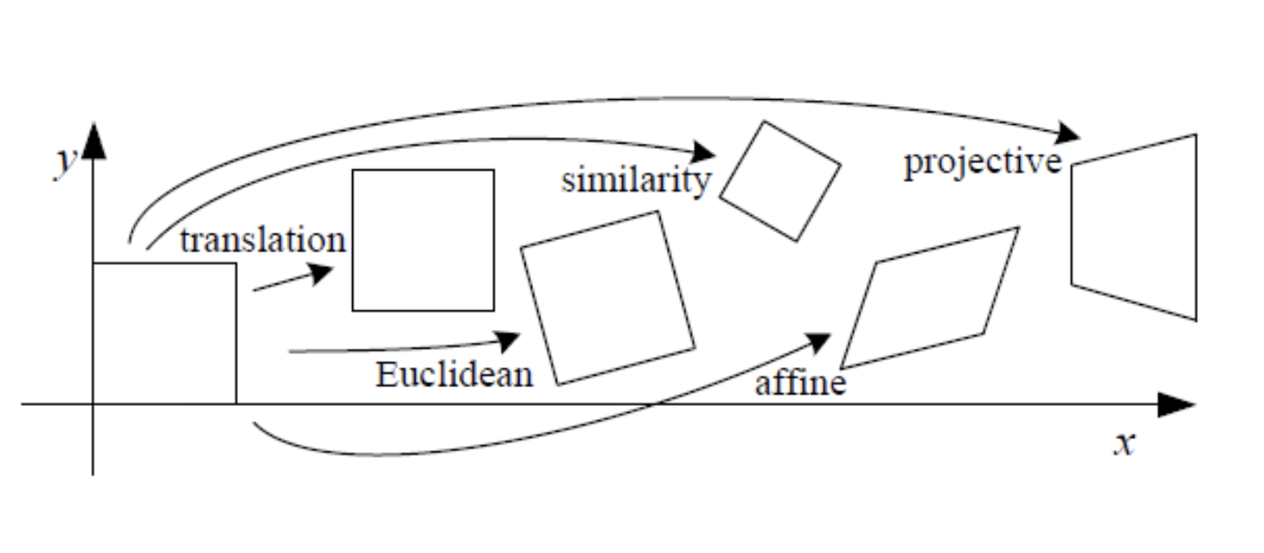
Future scope
Basic Set of 2‐D Transformation
Richard Szeliski, "Computer Vision: Algorithms and Application"
Szeliski, R. (2011). Figure 2.4 [Basic set of 2D planar transformations].
In Computer Vision: Algorithms and Applications. Springer.

Slide 25
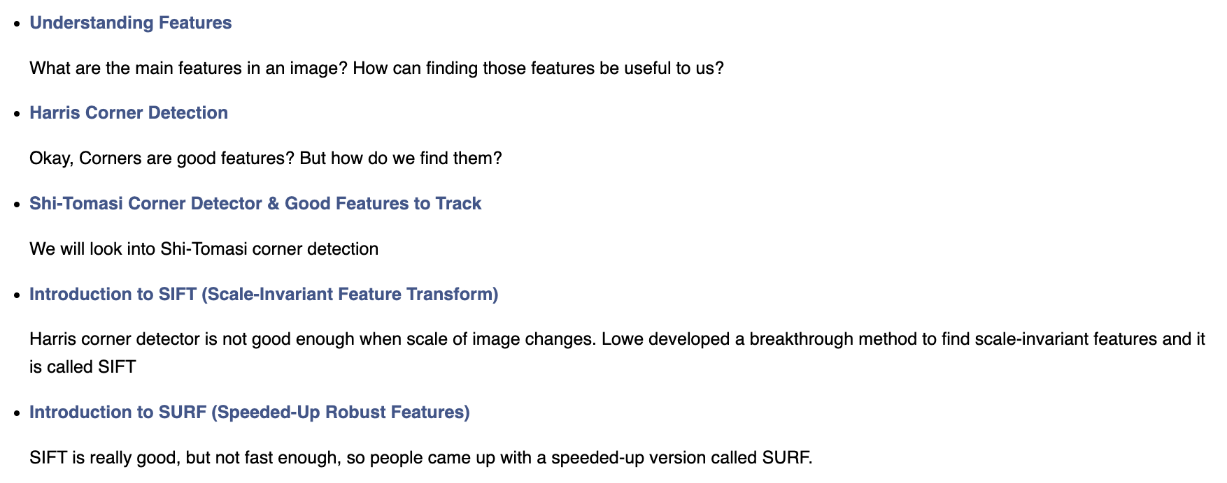
Feature Detection and Description

Slide 26
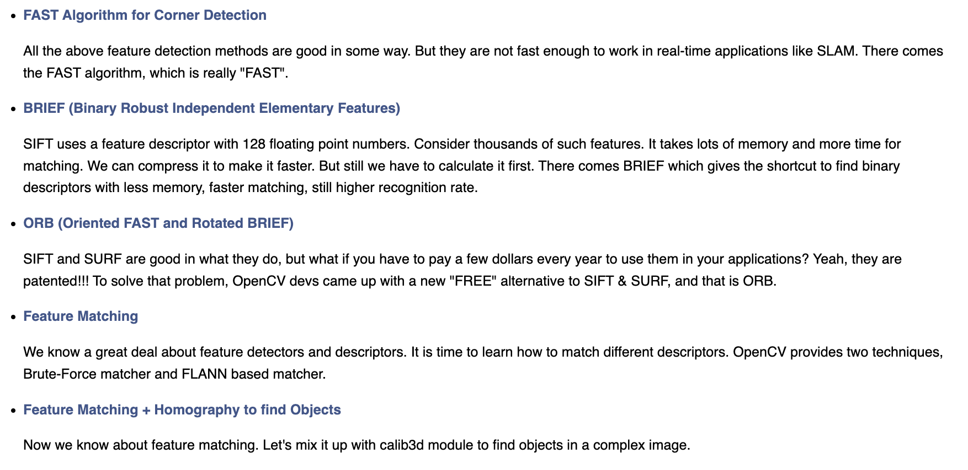
Feature Detection and Description

Slide 27
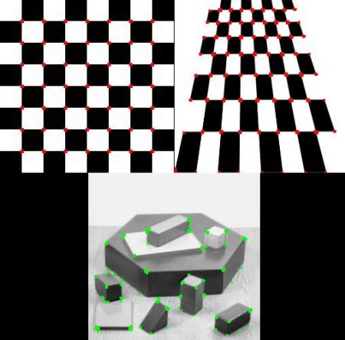
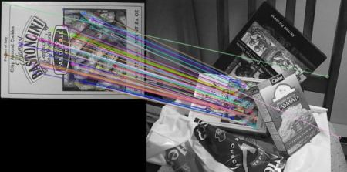
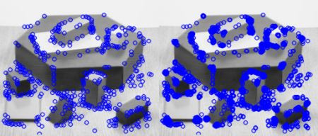
Feature Detections
OpenCV. (2021). Feature Detection and Description. OpenCV 4.7.0 documentation.
Retrieved from https://docs.opencv.org/4.7.0/d5/d51/group__features2d__main.html

Slide 28
KLT (Kanade-Lucas-Tomasi feature tracker)
CMU Computer Science. (2017). Tracking: Kalman Filter and KLT. Carnegie Mellon University.
Retrieved from https://www.cs.cmu.edu/~16385/s17/Slides/15.1_Tracking__KLT.pdf

Slide 29
Optical Flow Algorithms
OpenCV. (2021). Lucas-Kanade optical flow. OpenCV 4.7.0 documentation.
Retrieved from https://docs.opencv.org/4.7.0/db/d7f/tutorial_js_lucas_kanade.html

Slide 30
Thanks

